Slide 1

REVIEW OF RESEARCH PAPER
Steel Fiber Reinforced Concrete: A Review (2011)
- By Hamid Pesaran Behbahani, Behzad Nematollahi, Majid Farasatpour.
Published In:
Review paper on Steel Fiber Reinforced Concrete (SFRC)
Discusses properties, behavior, applications, and limitations of SFRC
NAME: M HEMA VARSHNI
YEAR & DEPT: 3rd Year Civil Engineering|
GUIDE NAME: Dr.Keerthana Kirupakaran

Slide 2
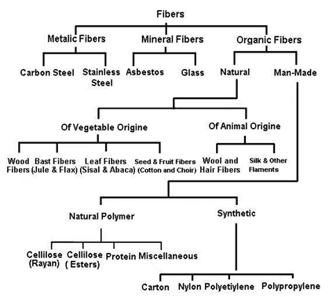
TYPES OF FIBERS
Classification of Fibers:
Problems in Conventional Concrete
The paper classifies fibers based on:
1. Modulus of Elasticity
High Elastic Modulus Fibers
  steel
  carbon
  glass
  Improve:
  flexural strength
  impact resistance
Low Elastic Modulus Fibers
  polypropylene
  vegetable fibers
  Mainly improve:
  impact resistance
2. Origin of Fibers
Metallic Fibers
  steel
  stainless steel
Mineral Fibers
  asbestos
  glass
Organic Fibers
  natural fibers
  synthetic fibers
Important Observation:
Different fibers provide different mechanical performance depending on:
stiffness
bond behavior
crack control ability
Fig 1. Fibers Classification (James Patrick Maina Mwangi, 1985)

Slide 3
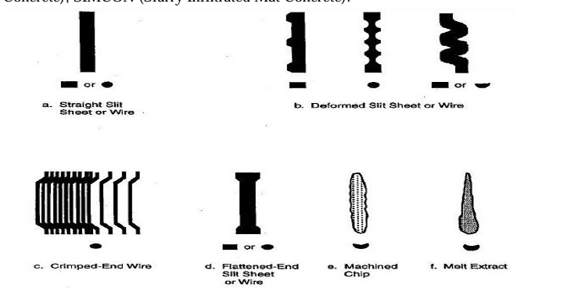
STEEL FIBER REINFORCED CONCRETE (SFRC)
Important Observation
Higher fiber volume improves:
toughness
ductility
crack resistance
But:
reduces workability.
SFRC Classification by Fiber Volume
1. Low Volume Fraction (<1%)
Used for:
shrinkage control
pavements
2. Moderate Volume Fraction (1–2%)
Improves:
flexural toughness
impact resistance
3. High Volume Fraction (>2%)
Used in:
blast resistant structures
SIFCON
SIMCON
Definition of SFRC:
According to ACI 544.IR (1996):
SFRC consists of:
cement
aggregates
water
randomly distributed steel fibers
Characteristics of Steel Fibers
Steel fibers have:
aspect ratio between 20–100
various cross-sections
different shapes
Fig 2. Different Shapes of Steel Fibers (ACI544.IR, 1996)

Slide 4
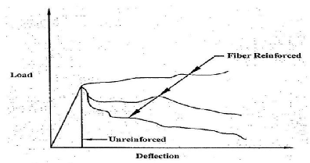
BENEFITS & APPLICATIONS OF SFRC
Benefits of SFRC:
The paper states that SFRC improves:
tensile strength
flexural strength
crack control
ductility
durability
Crack Bridging Mechanism
Steel fibers:
redistribute stresses
bridge cracks
improve post-cracking strength
Applications of SFRC:
The paper discusses applications in:
1. Pavements
  reduced slab thickness
  better fatigue resistance
2. Hydraulic Structures
  cavitation resistance
3. Fibre Shotcrete
  tunnel lining
  slope stabilization
4. Precast Structures
  pipes
  manhole covers
  machine bases
5. Structural Applications
  improved shear strength
  earthquake resistance
  blast resistance
Fig 3. Load-Deflection Curves for Plain and Fibrous Concrete (ACI 544.IR, 1996)

Slide 5
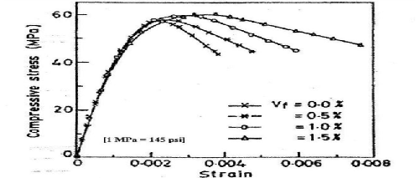
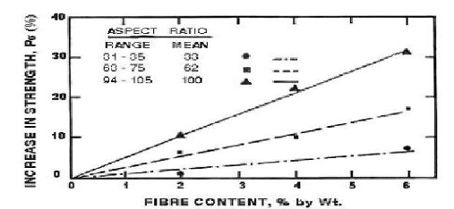
MECHANICAL PROPERTIES OF SFRC
Mechanical Properties Discussed
1. Compressive Strength
Addition of steel fibers:
increases compressive strength slightly
improves ductility and toughness
Increase observed:
about 0–15%
2. Shear Strength
SFRC significantly improves:
shear resistance
punching shear strength
Increase may reach:
up to 170%
3. Tensile Strength
Steel fibers improve:
crack resistance
post-cracking behavior
Increase depends on:
fiber orientation
fiber distribution
Fig 4. Effects of SFs Content on Compressive Stress-Strain Curve of FRC (Padmarajaiah and
Ramaswamy, 2002)
Important Insight:
Fibers mainly improve post-cracking performance and toughness rather than peak compressive strength.
Fig 5. Influence of Fibre Content on Tensile Strength (Johnston ACI-SP44-Detrpit 1974)

Slide 6
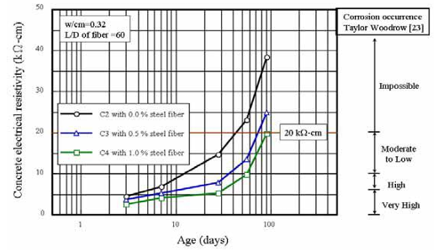
DURABILITY & FLEXURAL PERFORMANCE
Durability of SFRC:
The paper explains that SFRC:
reduces crack width
improves corrosion resistance
improves long-term durability
Corrosion Observation
Research showed:
only fibers near wide surface cracks corroded significantly
no major concrete spalling observed
Flexural Strength & Toughness:
1. Addition of steel fibers:
greatly improves flexural strength
increases energy absorption
improves impact resistance
2. Reported improvement:
flexural strength increased by ~55%
Electrical Resistivity:
Steel fibers reduce electrical resistivity because:
fibers are conductive
But hydration products later reduce conductivity effects.
Fig 6. Effects of Fibre Content on Concrete Electrical Resistivity (Tsai et al., 2009)

Slide 7
CONCLUSION & MAJOR FINDINGS
Major Findings of the Paper
1. SFRC significantly improves:
toughness
ductility
crack resistance
impact resistance
2. Steel fibers mainly improve:
post-cracking behavior
energy absorption
crack arresting capacity
3. Fiber performance depends on:
aspect ratio
geometry
distribution
orientation
4. SFRC has wide engineering applications
Especially in:
pavements
tunnels
hydraulic structures
seismic structures
Limitations Discussed
reduced workability
higher cost
mixing difficulties
fiber distribution challenges
Final Conclusion
The paper concludes that Steel Fiber Reinforced Concrete is an effective composite material capable of improving the mechanical performance and durability of concrete structures.

